Slide 1
Java Threads

Slide 2
“Threads allows a program to operate more efficiently by doing multiple things at the same time.”

Slide 3
Before we proceed with the first topic of this Java Thread blog, consider this example:-
Imagine a stockbroker application with lots of complex capabilities.
These are few of its functions:
To download the last stock option prices
To check prices for warnings
Analyze historical data for company XYZ

Slide 4
These are time-consuming functions. In a single-threaded runtime environment, these actions execute one after another. The next action can happen only when the previous one is finished.
“Now, if a historical analysis takes half an hour, and the user selects to perform a download and check afterward, the warning may come too late to, buy or sell stock as a result. We just imagined the sort of application that cries out for multithreading. Ideally, the download should happen in the background (that is, in another thread). That way, other processes could happen at the same time so that, for example, a warning could be communicated instantly. All the while, the user is interacting with other parts of the application. The analysis, too, could happen in a separate thread, so the user can work with the rest of the application while the results are being calculated.”
This is where Java thread helps. Let us understand Java Thread first:

Slide 5
What are Threads in Java ?
A thread is actually a lightweight process. Unlike many other computer languages, Java provides built-in support for multithreaded programming. A multithreaded program contains two or more parts that can run concurrently.
Each part of such a program is called thread and each thread defines a separate path of execution. Thus, multithreading is a specialized form of multitasking.

Slide 6
In Java, Multithreading refers to a process of executing two or more threads simultaneously for maximum utilization of the CPU.
A thread in Java is a lightweight process requiring fewer resources to create and shares the process resources.
Multithreading and Multiprocessing are used for multitasking in Java, but we prefer multithreading over multiprocessing.
This is because the threads use a shared memory area which helps to save memory, and also, the content-switching between the threads is a bit faster than the process.

Slide 7
Multitasking and Multithreading
Multitasking:
refers to a computer's ability to perform multiple jobs concurrently
more than one program are running concurrently, e.g., UNIX
Multithreading:
A thread is a single sequence of execution within a program
refers to multiple threads of control within a single program
each program can run multiple threads of control within it, e.g., Web Browser

Slide 8
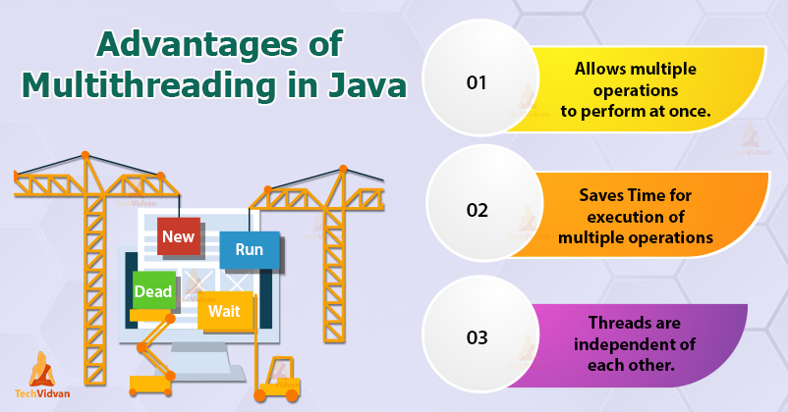

Slide 9
Application Thread
When we execute an application:
The JVM creates a Thread object whose task is defined by the main() method
The JVM starts the thread
The thread executes the statements of the program one by one
After executing all the statements, the method returns and the thread dies

Slide 10
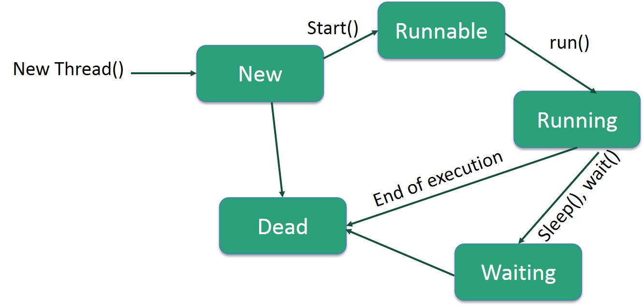
Life Cycle of a Thread

Slide 11
1. New
In this state, a new thread begins its life cycle. This is also called a born thread. The thread is in the new state if you create an instance of Thread class but before the invocation of the start() method.
2. Runnable
A thread becomes runnable after a newly born thread is started. In this state, a thread would be executing its task.
3. Running
When the thread scheduler selects the thread then, that thread would be in a running state.

Slide 12
4. Non-Runnable (Blocked)
The thread is still alive in this state, but currently, it is not eligible to run.
5. Terminated
A thread is terminated due to the following reasons:
Either its run() method exists normally, i.e., the thread’s code has executed the program.
Or due to some unusual errors like segmentation fault or an unhandled exception.
A thread that is in a terminated state does not consume ant cycle of the CPU.

Slide 13
Creating Threads
There are two ways to create our own Thread object
Subclassing the Thread class and instantiating a new object of that class
Implementing the Runnable interface
In both cases the run() method should be implemented

Slide 14
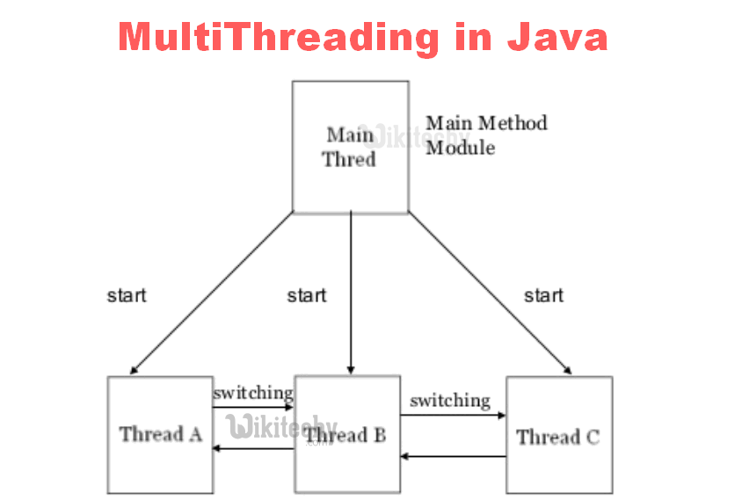

Slide 15
Extending Thread
public class ThreadExample extends Thread {
public void run () {
for (int i = 1; i <= 100; i++) {
System.out.println(“---”);
}
}
}

Slide 16
Thread Methods
void start()
Creates a new thread and makes it runnable
This method can be called only once
void run()
The new thread begins its life inside this method
void stop() (deprecated)
The thread is being terminated

Slide 17
Thread Methods
void yield()
Causes the currently executing thread object to temporarily pause and allow other threads to execute
Allow only threads of the same priority to run
void sleep(int m) or sleep(int m, int n)
The thread sleeps for m milliseconds, plus n nanoseconds

Slide 18
Implementing Runnable
public class RunnableExample implements Runnable {
public void run () {
for (int i = 1; i <= 100; i++) {
System.out.println (“***”);
}
}
}

Slide 19
Refer to the examples

